Slide 1
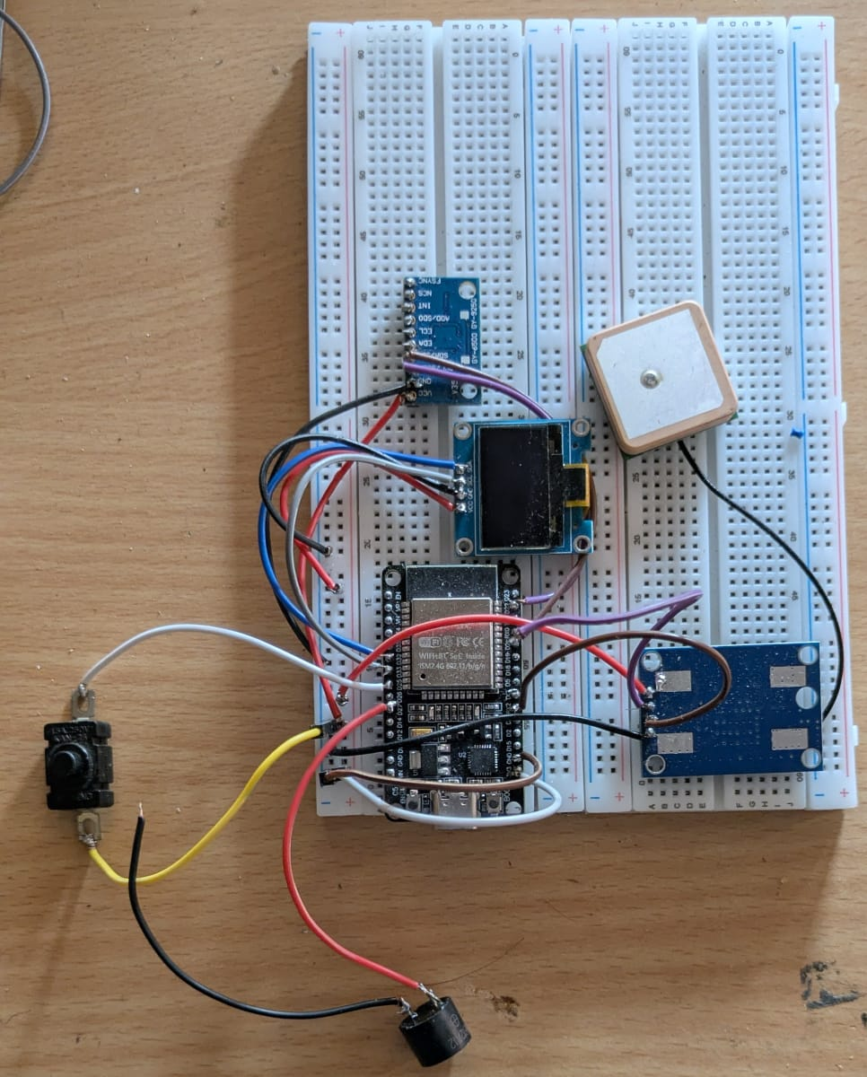
IoT-Based Vehicle
Accident Detection
& Emergency Alert System
ESP32 • Sensor Fusion • GPS • Telegram • SMS API • LoRa
Major Project Presentation | B.Tech CSE (IoT) | May 2026
Guide: Prof. Bhawana Singh

Slide 2
Problem: accident alerts are often delayed
The system is designed to shorten the time between accident detection and emergency contact notification.
ACCIDENT
EVENT
NO QUICK
LOCATION
CONTACT
DELAY
LATE
RESPONSE
AUTOMATED
ALERT
The main challenge is to detect accident-like motion reliably, confirm it before sending false alerts, and deliver a GPS-based emergency message through multiple communication channels.
5
3
10s
GPS
Buzzer
Detection states
Alert channels
Cancel window
Location link
Local warning
IoT-Based Vehicle Accident Detection & Emergency Alert System
02

Slide 3
Project snapshot
A compact IoT prototype that senses accident conditions and automatically communicates the location.
What it does
Detects impact and abnormal tilt using MPU9250/6500 sensor fusion
Fetches latitude, longitude and speed from GPS module
Shows live status on OLED and warns locally through buzzer
Sends accident alert through Telegram, Fast2SMS and LoRa
Avoids false alerts using cancel button before final confirmation
Breadboard prototype with ESP32, MPU, GPS, OLED, buzzer and cancel button
Real-time monitoring + emergency messaging
IoT-Based Vehicle Accident Detection & Emergency Alert System
03

Slide 4
Project objectives
The design combines detection accuracy, user safety and multi-channel communication.
1
Sense accident motion
2
Confirm before alert
3
Attach GPS location
Measure acceleration, gyroscope movement and tilt changes using MPU9250/6500.
Use impact + tilt + time-window logic and cancel button to reduce false messages.
Generate latitude, longitude, speed and Google Maps link automatically.
4
Notify contacts
5
Show live status
Send emergency alert using Telegram Bot, Fast2SMS and LoRa receiver.
Use OLED and buzzer to make the prototype understandable during demo.
IoT-Based Vehicle Accident Detection & Emergency Alert System
04

Slide 5
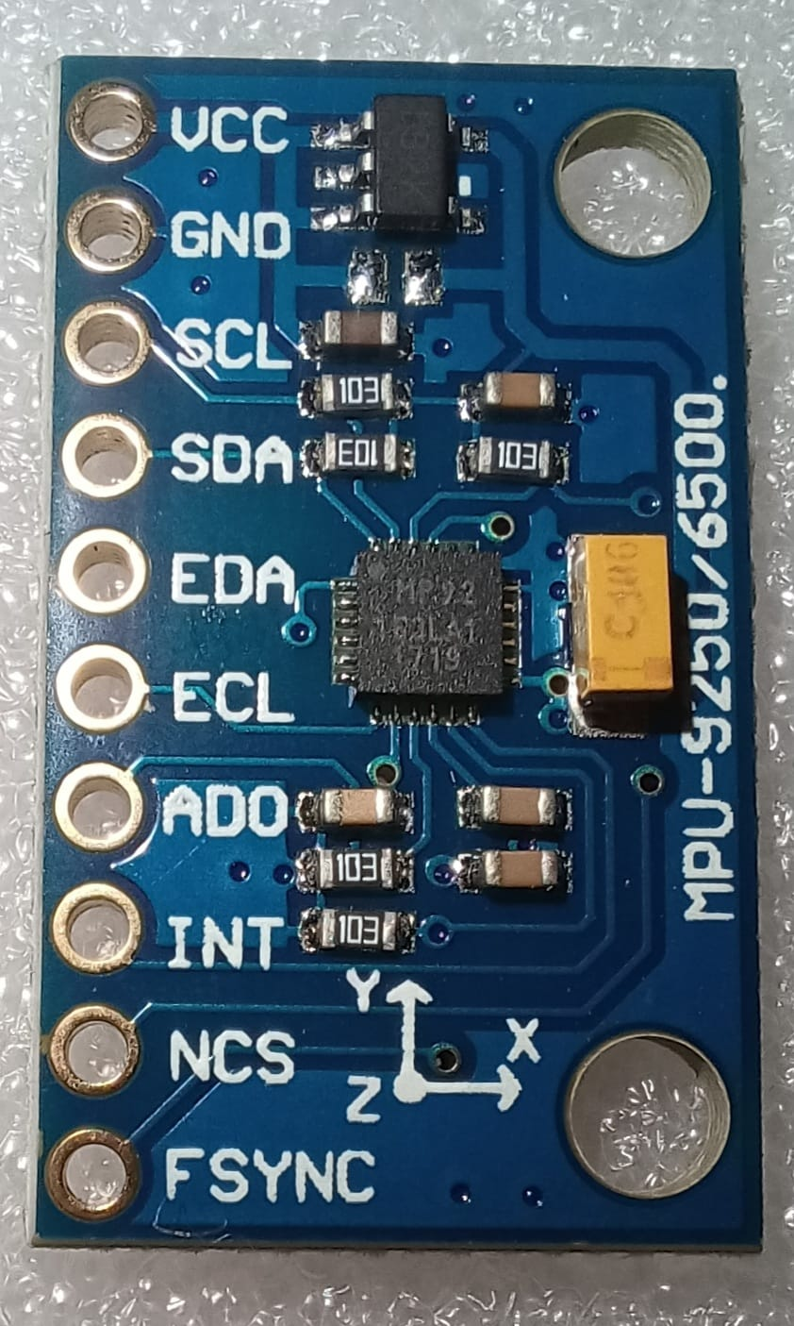
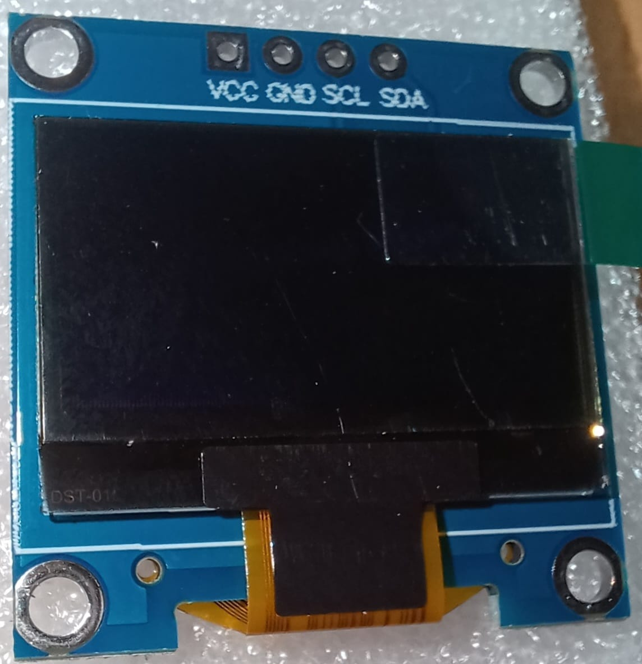
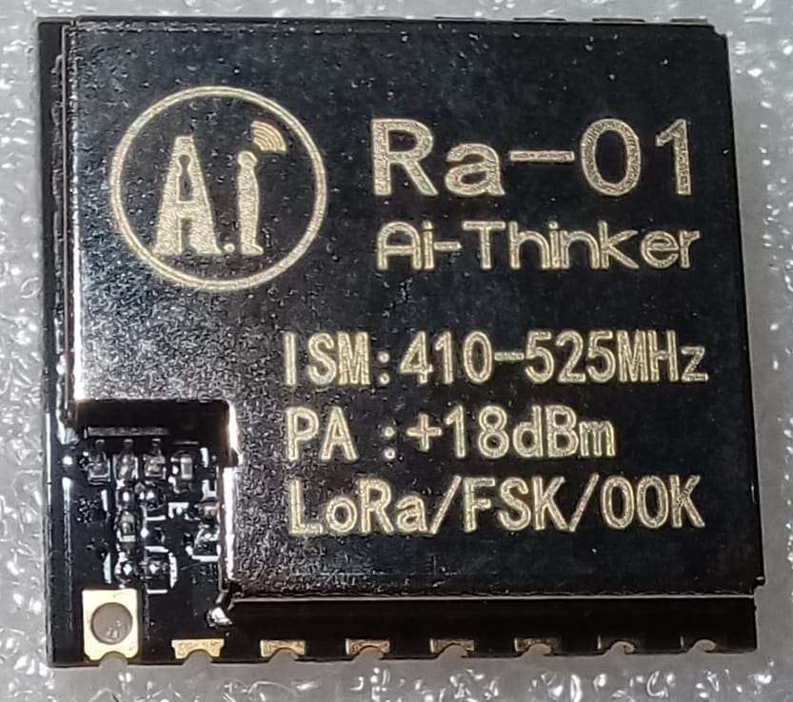
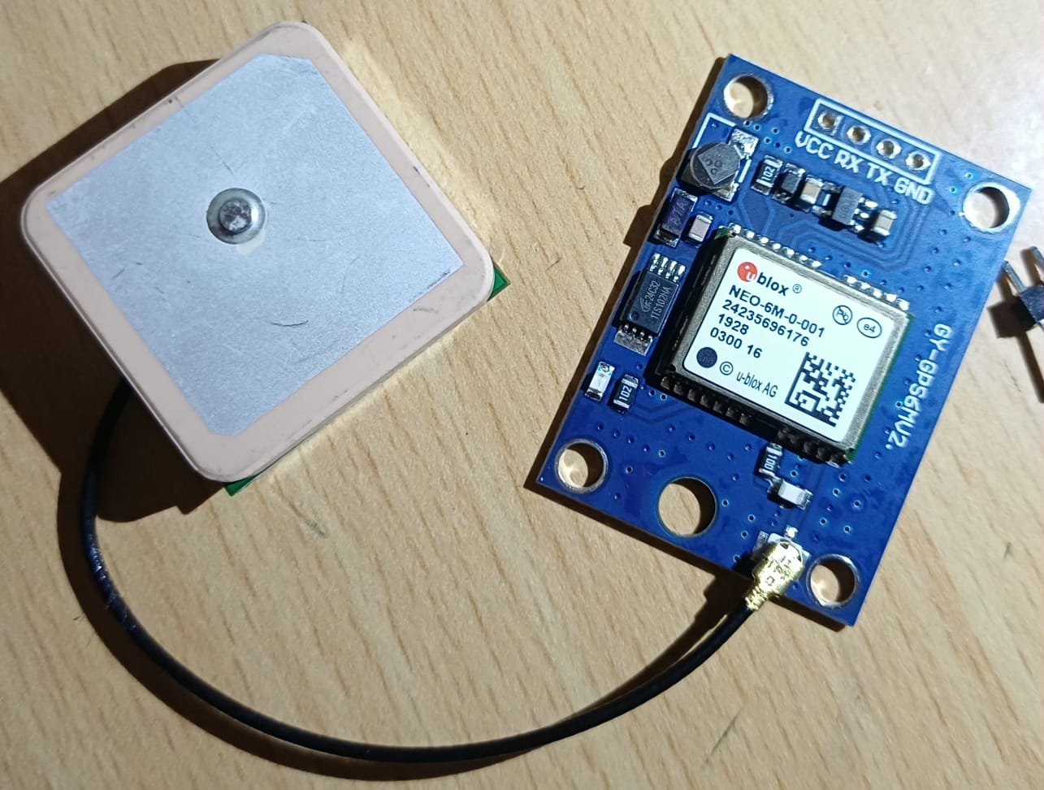
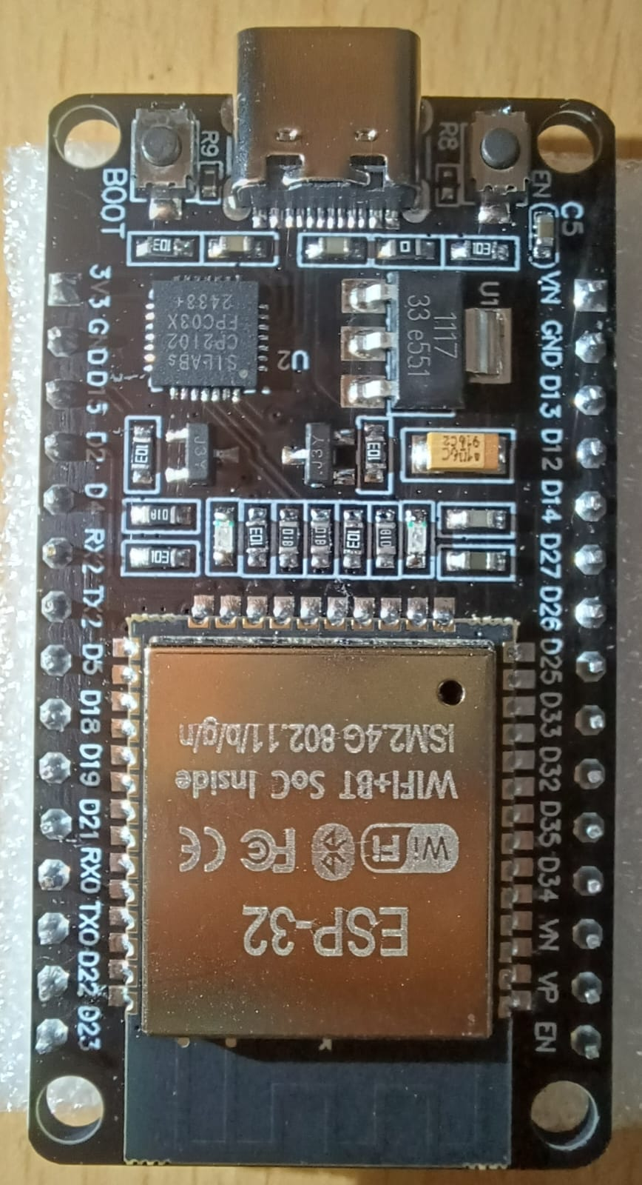
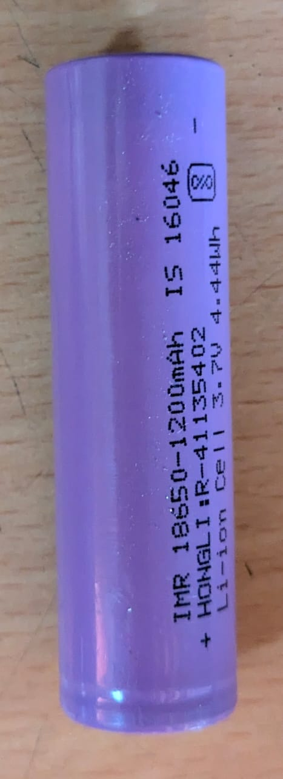
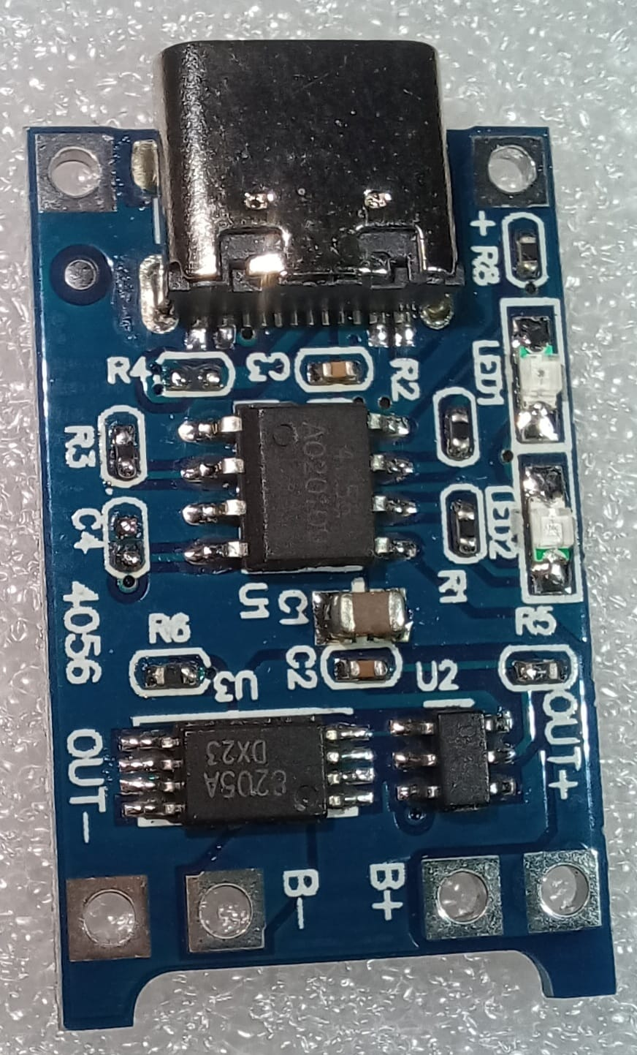
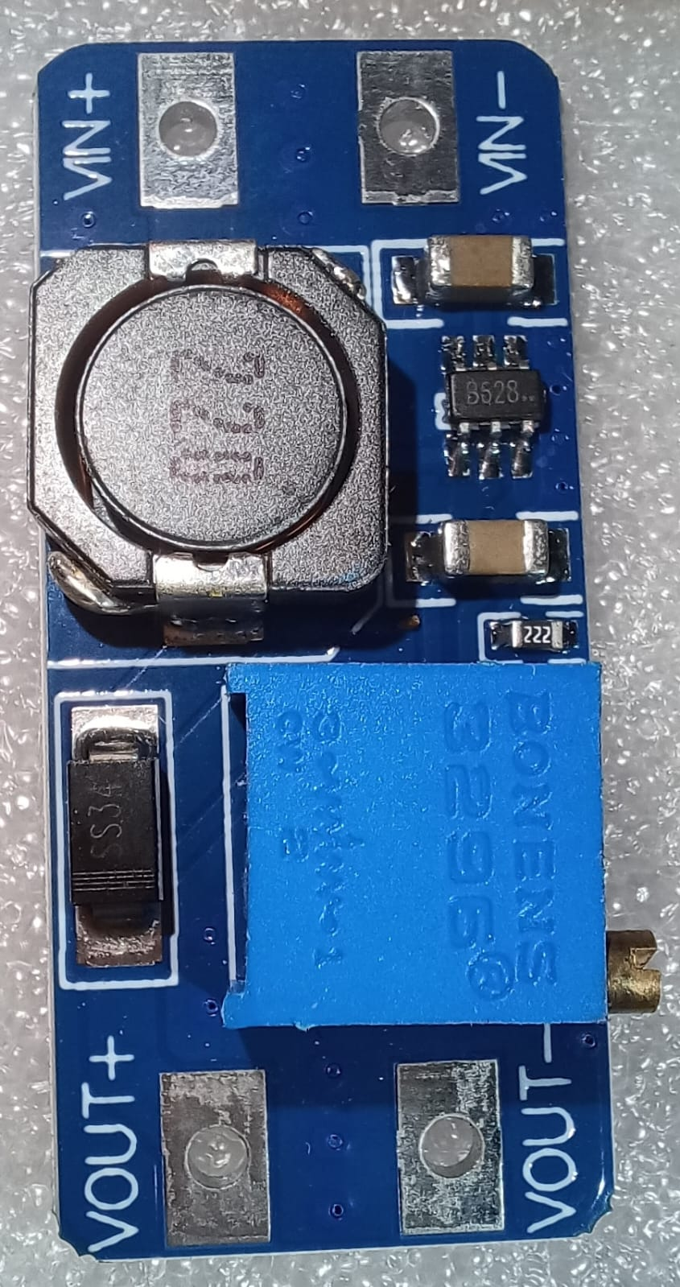
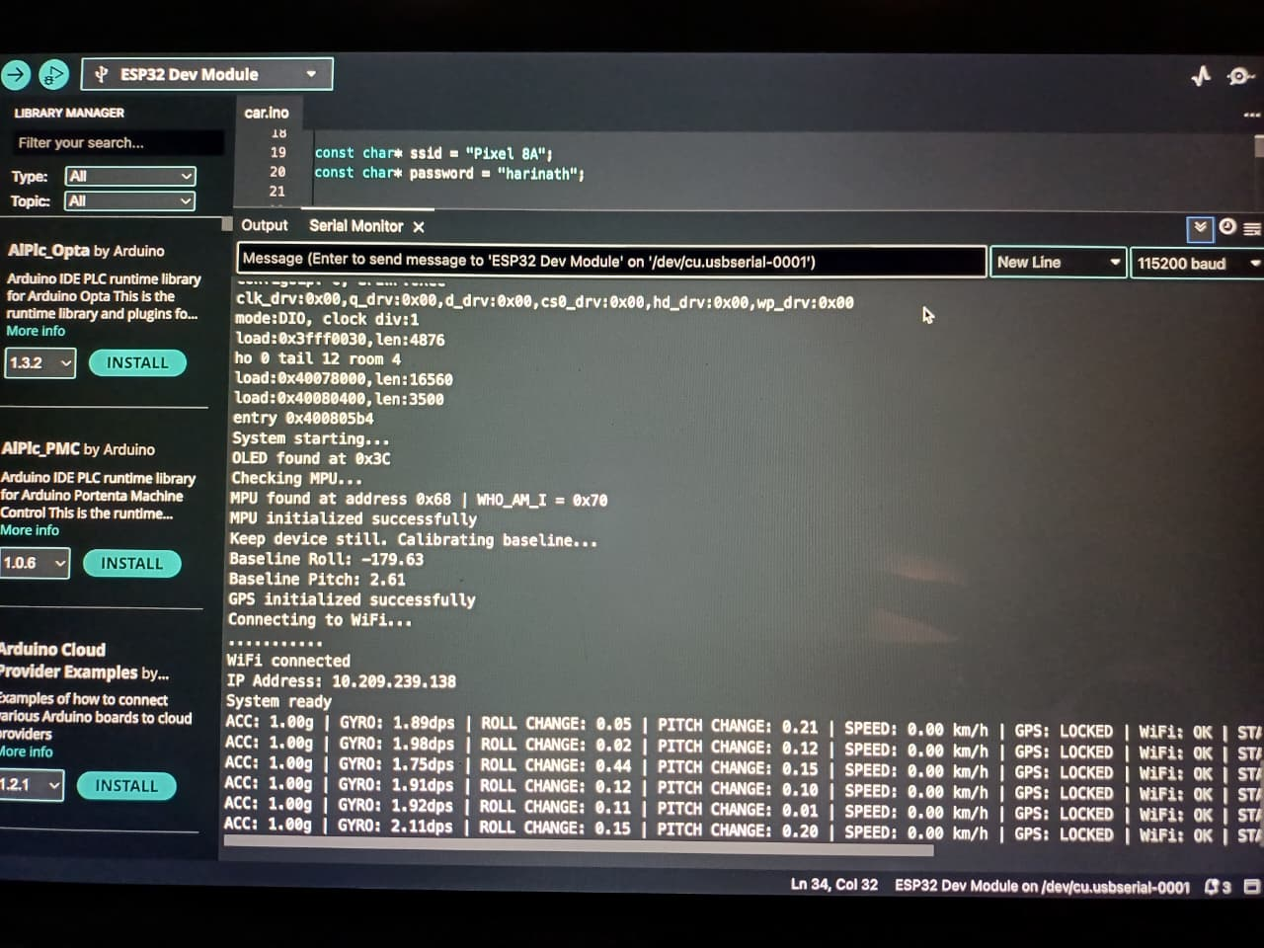
Hardware used in the prototype
Core sensing, processing, display, power and communication modules.
MPU9250/6500
NEO-6M GPS
OLED display
LoRa Ra-01
ESP32 controller
Buzzer + cancel
TP4056
MT3608 boost
18650 cell
IoT-Based Vehicle Accident Detection & Emergency Alert System
05

Slide 6
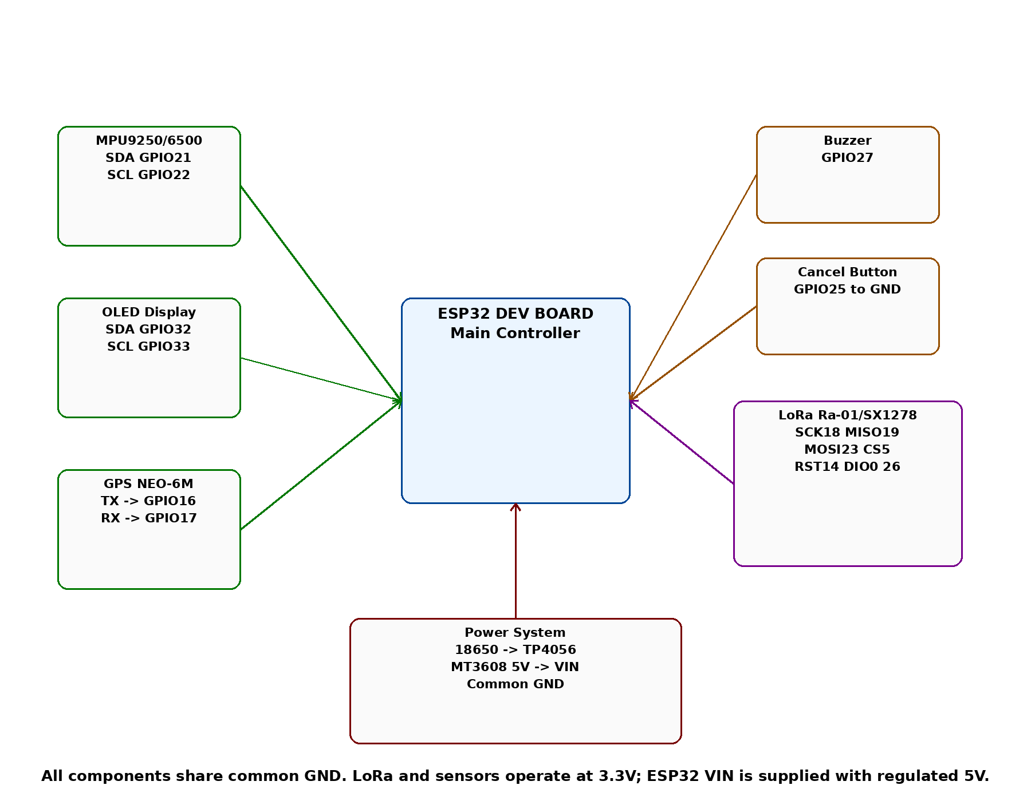
Final circuit connections
Key pin mapping and power chain used for the working prototype.
Module
ESP32 connection
MPU SDA/SCL
GPIO21 / GPIO22
OLED SDA/SCL
GPIO32 / GPIO33
GPS TX/RX
GPIO16 / GPIO17
Buzzer
GPIO27
Cancel button
GPIO25 to GND
LoRa SPI
SCK18 MISO19 MOSI23 CS5 RST14 DIO0 26
Power chain
18650
Cell
TP4056
Charging
MT3608
5V
Final connection diagram
Common GND is mandatory for all modules.
IoT-Based Vehicle Accident Detection & Emergency Alert System
06

Slide 7
System architecture
A layered IoT architecture: sensing, processing, decision, display and communication.
Sensors
MPU + GPS
ESP32
Processing
Decision
Engine
Outputs
OLED + Buzzer
Alerts
TG + SMS + LoRa
Acceleration, gyro, tilt, speed, coordinates
Filters readings and calculates magnitudes
Impact + tilt + 10 s cancel window
Shows status and local warning
Sends location link to contacts
Sensor fusion converts raw motion into reliable accident decision
IoT-Based Vehicle Accident Detection & Emergency Alert System
07

Slide 8
Accident detection logic
The prototype confirms an accident only when multiple conditions match within a time window.
Core idea
Impact condition
ACC_MAG > threshold
or GYRO_MAG > threshold
Tilt condition
Roll/Pitch change
> angle threshold
A single jerk or tilt alone should not immediately send emergency messages. The system combines impact, rotation, tilt and confirmation time to avoid false alerts.
Both occur within
detection window
Decision rule
Impact + Tilt + Confirmation Delay → Accident Confirmed
ACCIDENT SUSPECTED
Cancel button active
ACCIDENT CONFIRMED
Alerts transmitted
Cancel button stops false alert before messages are sent.
IoT-Based Vehicle Accident Detection & Emergency Alert System
08

Slide 9
System workflow
The working sequence from power-on to alert delivery.
Power ON
Initialize MPU, GPS, OLED, WiFi, LoRa
Calibrate
Set normal roll/pitch baseline
Monitor
Read ACC, gyro, tilt and GPS speed
Suspect
Impact + tilt detected
Cancel?
User gets 10 seconds to stop false alert
Confirm
Accident confirmed and alerts sent
Button pressed
ALERT CANCELLED
No message sent
If cancel is not pressed, the system confirms accident and triggers Telegram + SMS + LoRa.
IoT-Based Vehicle Accident Detection & Emergency Alert System
09

Slide 10
Communication model
Three alert paths share the same accident message with GPS link.
Telegram Bot API
Internet message
Maps link opens directly
LoRa Ra-01/SX1278
RF packet to receiver
Long range local backup
ESP32
Accident confirmed
Message prepared
Fast2SMS API
Normal SMS alert
No app required
Alert format: ACCIDENT CONFIRMED | Latitude | Longitude | Speed | Google Maps Link
IoT-Based Vehicle Accident Detection & Emergency Alert System
10

Slide 11
LoRa transmitter–receiver alert path
LoRa is included as an RF communication path in the final model.
Transmitter side
ESP32 sends packet
when accident is confirmed
LoRa RF link
410–525 MHz
Packet reaches receiver
Receiver/gateway
Displays/logs packet
can forward to contact
Ai-Thinker Ra-01 LoRa module
Message packet
ACCIDENT_CONFIRMED | LAT: 25.461xxx | LON: 85.511xxx | SPEED: 0.00 km/h | MAP_LINK
Use in presentation: LoRa demonstrates that the system is not limited to internet-only communication. The receiver can act as a local emergency gateway in remote or weak-network regions.
IoT-Based Vehicle Accident Detection & Emergency Alert System
11

Slide 12
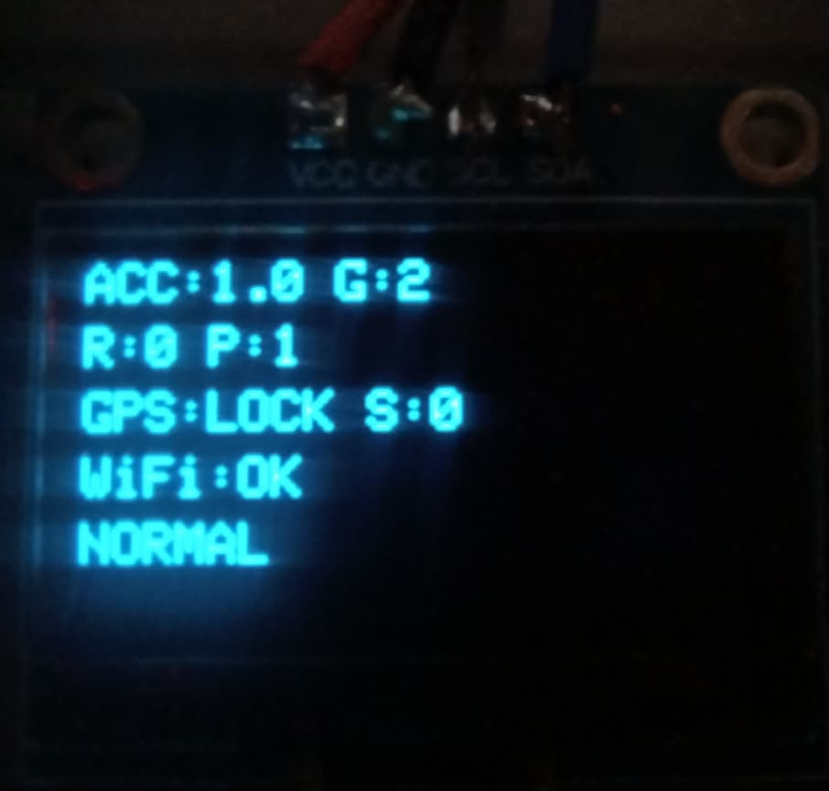
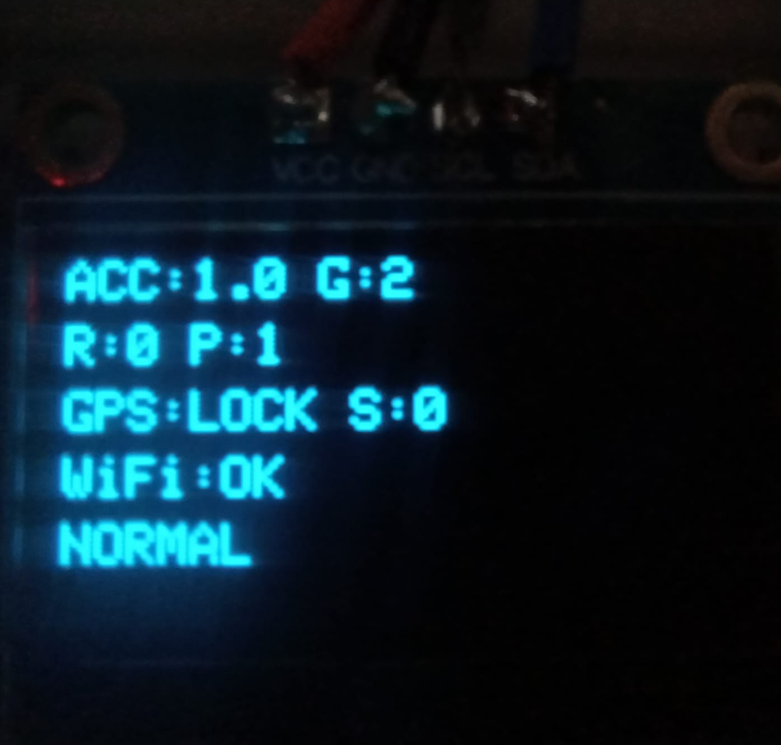
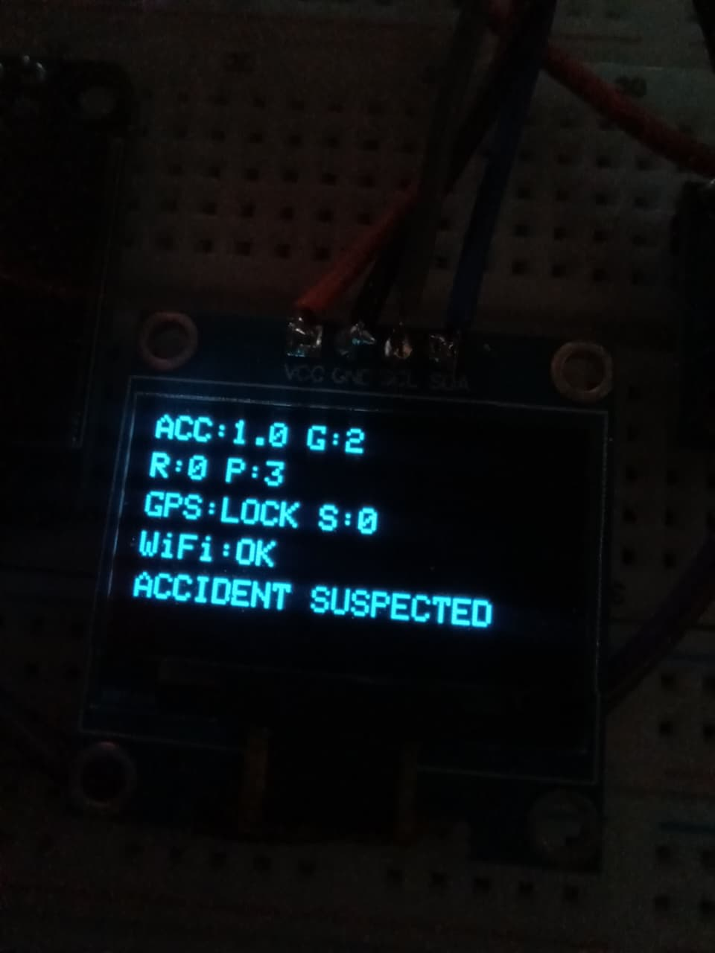
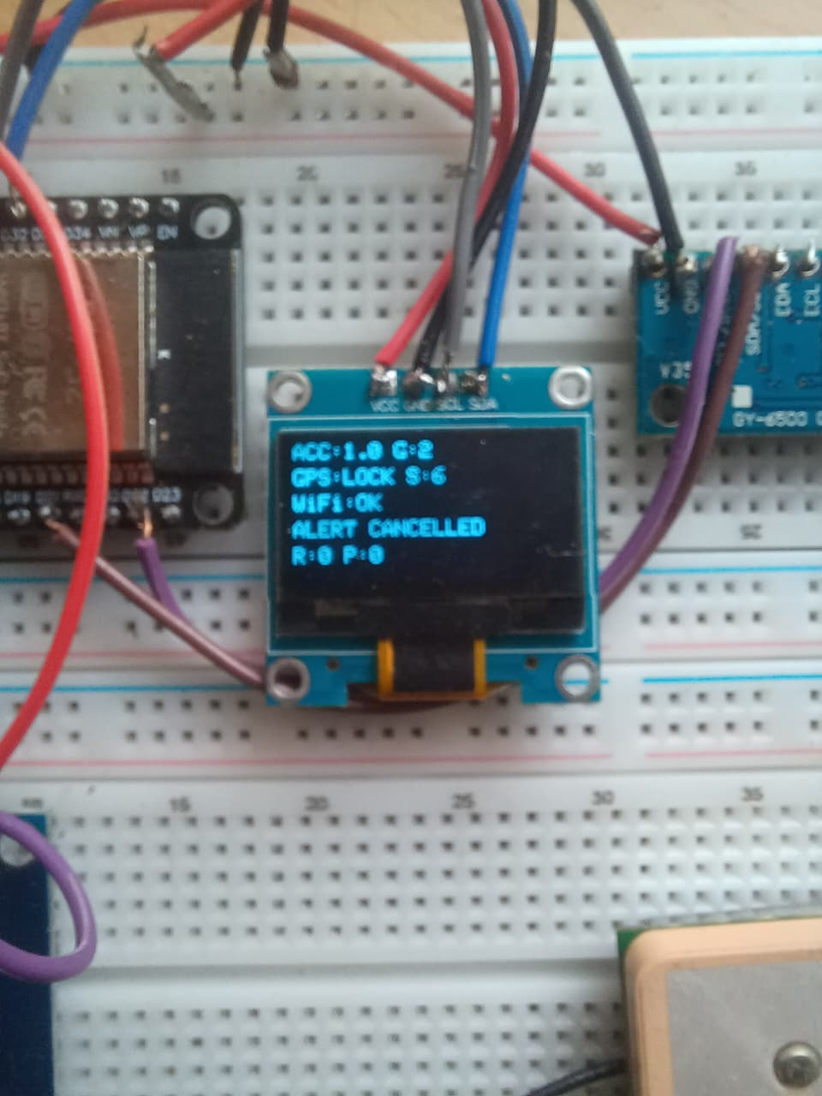
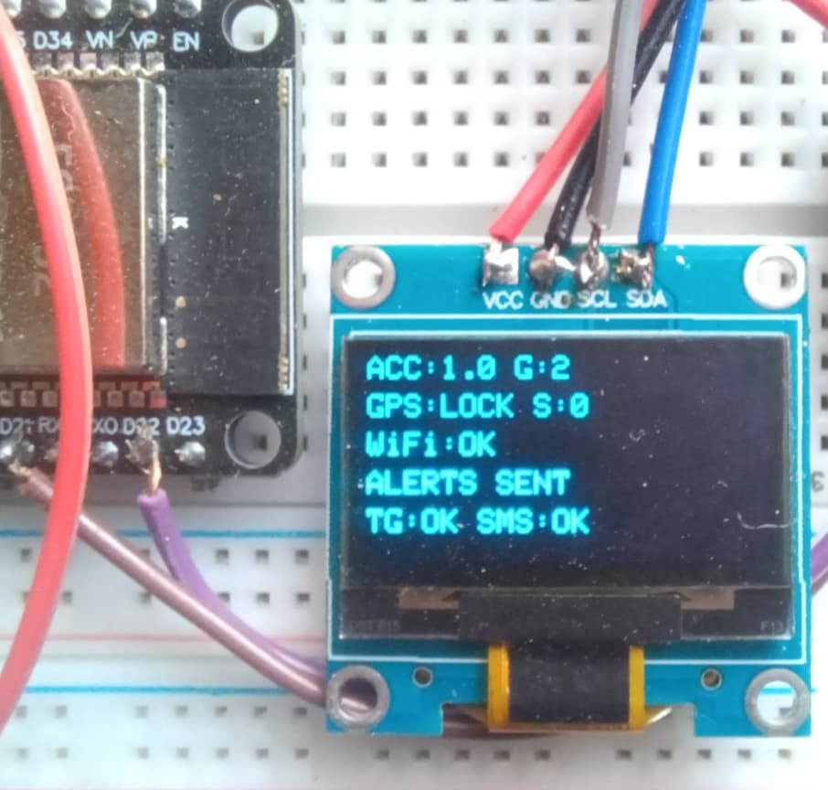
Real-time OLED status outputs
The OLED makes the prototype easy to understand during live demonstration.
Normal
Tilt detected
Accident suspected
Alert cancelled
Alerts sent
Shown states: NORMAL → TILT DETECTED → ACCIDENT SUSPECTED → ALERT CANCELLED or ALERTS SENT
This visual feedback helps the user verify GPS lock, WiFi status, speed, sensor readings and final alert status without using Serial Monitor.
IoT-Based Vehicle Accident Detection & Emergency Alert System
12

Slide 13
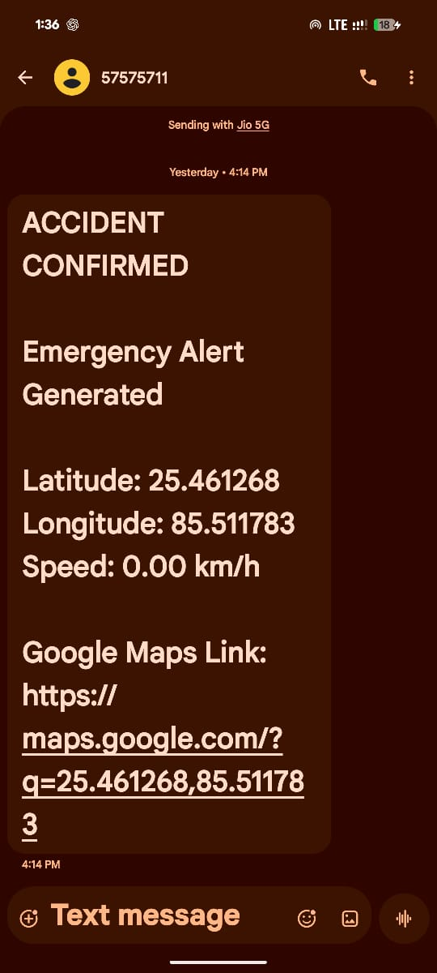
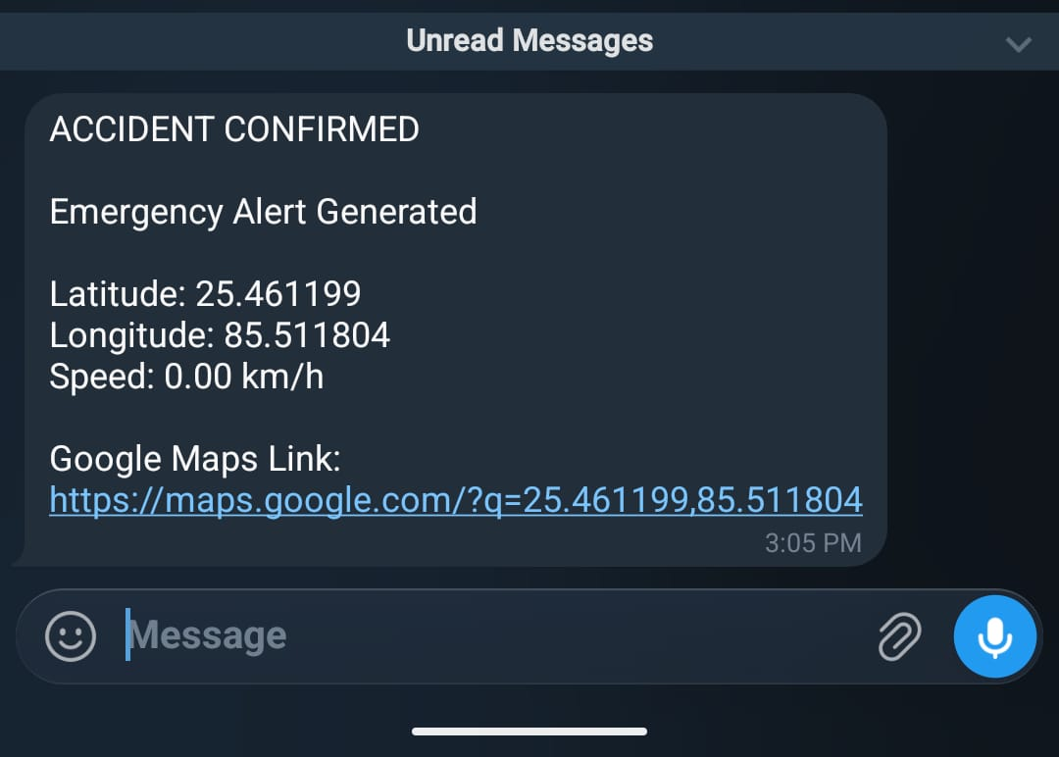
Emergency alert messages received
Both Telegram and normal SMS carry the accident status and GPS location link.
Telegram Bot message received
Fast2SMS normal SMS received
Message includes: Accident Confirmed • Latitude • Longitude • Speed • Google Maps Link
IoT-Based Vehicle Accident Detection & Emergency Alert System
13

Slide 14
Testing summary
The prototype was verified through module-level and system-level output states.
Normal state
OLED shows NORMAL, GPS LOCK and WiFi OK
PASS
Tilt test
OLED shows TILT DETECTED when roll/pitch threshold crosses
PASS
Accident test
OLED shows ACCIDENT SUSPECTED then confirms after cancel window
PASS
Cancel button
Alert cancelled and no emergency message sent
PASS
Telegram alert
Message received with Google Maps link
PASS
Fast2SMS alert
Normal SMS received with GPS link
PASS
LoRa alert path
Transmitter/receiver packet included as RF alert path
PASS
IoT-Based Vehicle Accident Detection & Emergency Alert System
14

Slide 15
False-alert control and reliability features
The project includes safeguards so the alert is not sent on every small movement.
Built-in safeguards
Baseline calibration
Normal mounting position is recorded at startup.
Two-condition logic
Impact/rotation and tilt must occur within a detection window.
10-second cancel window
User can stop false alert before messages are sent.
Cancel button result: alert cancelled
Alert status feedback
OLED confirms whether TG/SMS messages were sent.
Local buzzer warning
Buzzer warns during suspected/confirmed state and stops when alerts complete.
IoT-Based Vehicle Accident Detection & Emergency Alert System
15

Slide 16
Future scope and real-world extension
The same prototype can be extended toward a deployable emergency response platform.
ERSS-112 integration
Future alert routing through approved government emergency response integration after official permission.
Cloud dashboard
Store accident history, live vehicle status and location trails.
Mobile application
Family members can track alerts, cancel false alarms and call emergency services.
ML-based detection
Use real driving data to tune thresholds and reduce false positives.
Rugged enclosure
Waterproof, shock-resistant vehicle-mounted hardware.
Vehicle power interface
Direct vehicle battery interface with protection circuitry.
Important: government emergency alerts require approved ERSS integration and authorization.
IoT-Based Vehicle Accident Detection & Emergency Alert System
16

Slide 17
Conclusion
The project demonstrates a practical IoT-based accident detection and emergency alert system using real hardware, GPS location, live OLED feedback and multi-channel alert delivery.
Accident detection
Alert delivery
Impact, gyro and tilt-based confirmation
Telegram + SMS + LoRa message path
False alert control
Real-time visibility
Cancel button before final confirmation
OLED status and local buzzer feedback
Thank You

